Slide 1

SUPERMARKET MANAGEMENT SYSTEM
SDP REVIEW-2
P.JEEVAN-2000031859
M.KIRANKANTH-2000031801
SHAIKJAHEER-2000031903

Slide 2
FUNCTIONAL REQUIREMENTS
A product features or functions that developers must implement to enable users to accomplish their tasks. So, it’s important to make them clear both for the development team and the stakeholders. Generally, functional requirements describe system behavior under specific conditions. For example
The system sends an approval request after the user enters personal information.
A search feature allows a user to hunt among various invoices if they want to credit an issued invoice.
The system sends a confirmation email when a new user account is created.

Slide 3
MODULES
Finance and Accounting Module.
Sales and Distribution Module.
Production Management Module.
Quality Management System Module.
Supply Chain Management Module.

Slide 4
ANALYSIS
Purchasing
Managing full supermarket
Managing Inventory
Supply-Chain Management and Logistics
Handling Multi-Location Stores
Manage Pricing, Discount Offers
Predict Seasonal Demands and More

Slide 5

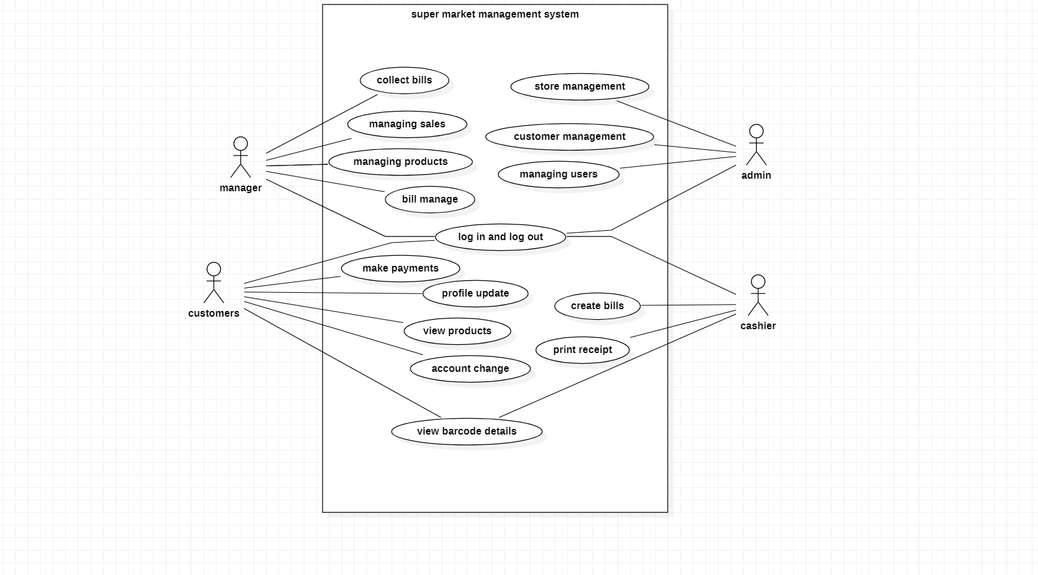

Slide 6
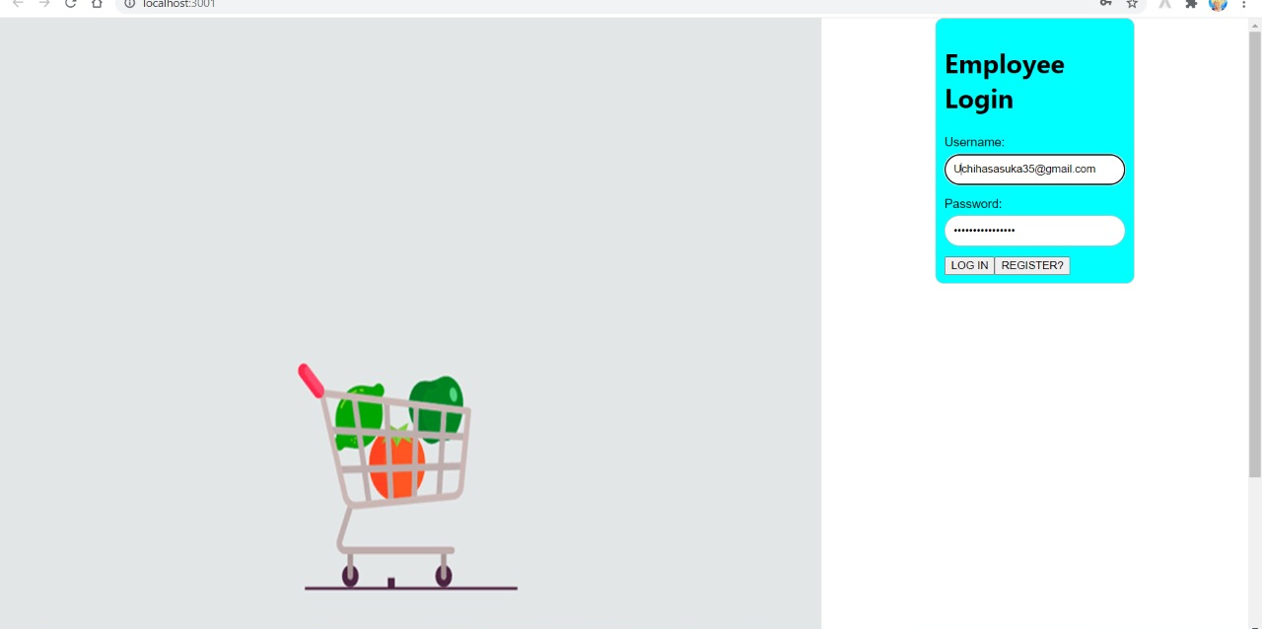

Slide 7
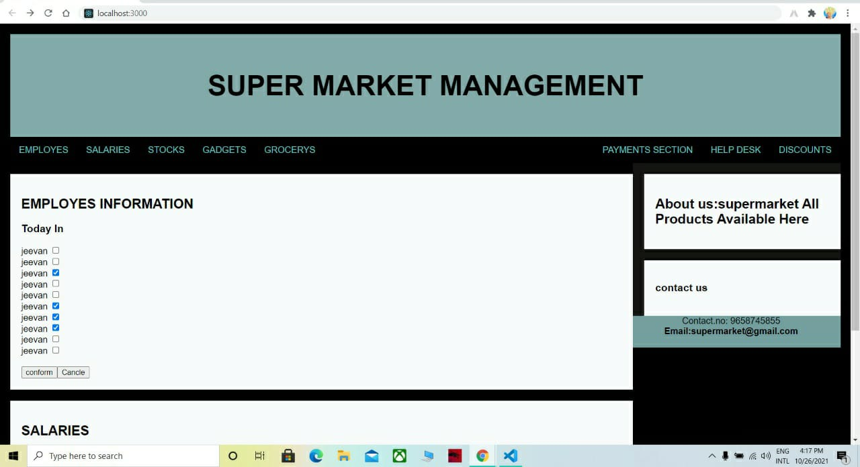

Slide 8
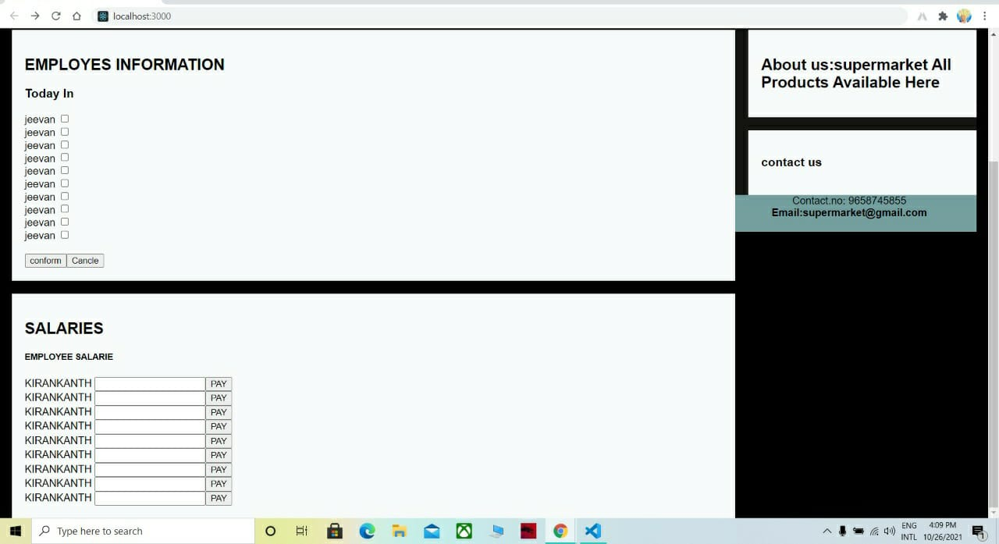

Slide 9

THANK YOU

